Slide 1

Car Price Prediction
1.Meet Bohra (20104057)
2.Shivam Gupta (20104110)
3.Yashab Mahimi (20104026)
4. Kaif Khan (20104128)
Project Guide
Ms. Geetanjali Kalme

Slide 2
Contents
Introduction
Objectives
Scope
Literature Survey
Proposed System
Project Outcome
Flow chart
Use Case/DFD
Technology Stack
Suggestions in Review-1
Result and discussion
Conclusion and Future scope
References

Slide 3
1. Introduction
As the demand of car is increasing , the second-hand car market has been growing in popularity, providing opportunities for both Buyers and Sellers.
Buying a used car is the best option for customer in several countries because the price is fair and affordable. However many factor effect the price of a used car, including its age and current condition.
In most cases, the price of a used car on the market fluctuates. As a result, a model evaluating car price is needed to assist in trading.
The main goal of this system is to find the best predictive model for car price prediction. Predicting a car’s resale value is not an easy job. The value of a car determined by a variety of variables. The most significant ones are typically the car age, model, origin, mileage and origin.

Slide 4
2. Objectives
To develop a efficient and effective model which predicts the price of a used car according to user’s inputs.
To design a model for a given dataset and predict the car price with better accuracy.
3) To develop a User Interface which is user friendly and takes inputs from the user and predicts the price.
4) The system that is being built must be feature based i.e feature wise prediction must be possible.

Slide 5
3. Scope
1) To develop an accurate model that can predict price for each vehicle.
2) Collecting and analyzing historical data for each vehicle and help identify market price.
3) Algorithms like random forest regression can be used to predict price of vehicle based on the features.

Slide 6
4.Literature Survey
Sr. No. | Title | Authors | Year | Algorithm | Results
1 | Predicting Car Prices Using Multiple Linear Regression | Sandhu, S. & Kaur, S. | 2019 | Multiple Linear Regression | R-squared value of 0.78
2 | A Comparative Analysis of Regression Models for Car Price Prediction | Rajput, N., Swami, V., & Jain, A. | 2021 | Linear Regression, Lasso Regression, Random Forest Regression | Lasso Regression achieved the best performance with an R-squared value of 0.91
3 | Car Price Prediction Using Machine Learning Techniques | Azam, F. & Hossain, M. | 2021 | Linear Regression, Random Forest Regression, K-Nearest Neighbors Regression, | Random Forest Regression achieved the best performance with an R-squared value of 0.84

Slide 7
5. Algorithm Used
Random Forest Regression
A random forest is a meta estimator that fits a number of classifying decision trees on various sub-samples of the dataset and uses averaging to improve the predictive accuracy and control over-fitting.
Linear Regression
Linear regression analysis is used to predict the value of a variable based on the value of another variable. The variable you want to predict is called the dependent variable.

Slide 8
6.Proposed System
Feature 1:
Competitive pricing: User is getting a competitive selling price for his/her vehicle
Feature 2:
User-friendly GUI: User is provided with an easy-to-use website and thus improving user experience

Slide 9
7. Outcome of Project
1. An application using ML which determine the correct reselling price of cars.
2. Customer can select the car type and features.
3. A User Interface which is user friendly and takes inputs from the user and predicts the price.

Slide 10
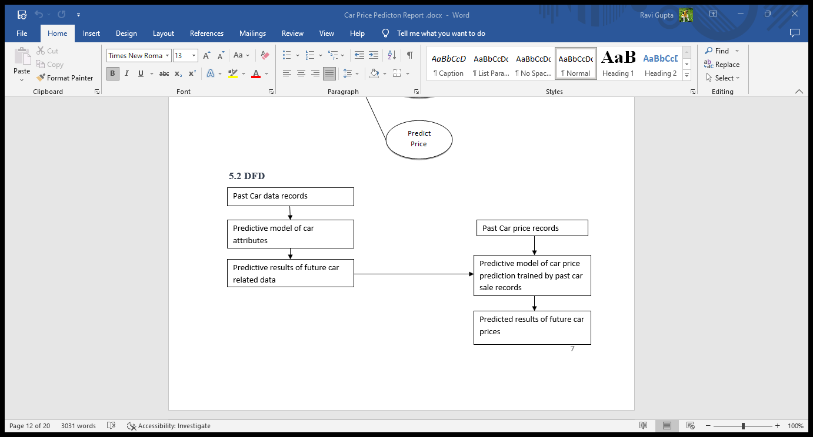
8. DFD

Slide 11
9. Flow Chart
Start
Collect Dataset
Data Processing
Random Forest Regression
Linear Regression
Select the best model
Display the Predicted price
Stop

Slide 12
10. Technology Stack
Front end : 1)Python
2)Html & CSS
Back end: 1) MySQL
2) Flask
Operating System: Windows 11
Development environment : Jupyter Notebook

Slide 13
Suggestions in Review-1
Make the User Interface better
Add More Attributes to the Data set

Slide 14
Result and Discussion
Result
Metric | Value
MSE | 0.034
MAE | 0.148
R2 | 0.947
Discussion
Overall, Random Forest Regression is a promising model for car price prediction with high accuracy and low error rates.
Future research could explore other regression models or compare the performance of Random Forest Regression to other models on different datasets.

Slide 15
11. Conclusion and Future Scope
Conclusion:
Car price prediction can be a challenging task due to the high number of attributes that should be considered for the accurate prediction. Our Prediction will help the Customers to buy or sell their cars according to the market value.
Future Scope:
In future this machine learning model may bind with various website
which can provide real time data for price prediction. Also we may add large historical data of car price which can help to improve accuracy of the machine learning model. For better performance, we plan to judiciously design deep learning network structures, use adaptive learning rates and train on clusters of data rather than the whole dataset.

Slide 16
References
https://ijirase.com/assets/paper/issue_1/volume_4/V4-Issue-2-629-632.pdf
https://www.irjmets.com/uploadedfiles/paper/volume3/issue_3_march_2021/6681/1628083284.pdf

Slide 17
Thank You...!!

